Slide 1
How to install Unity 3D
SoftUni Unity 3D Basics Course
SoftUni Team
Technical trainers
Software University
https://softuni.org

Slide 2
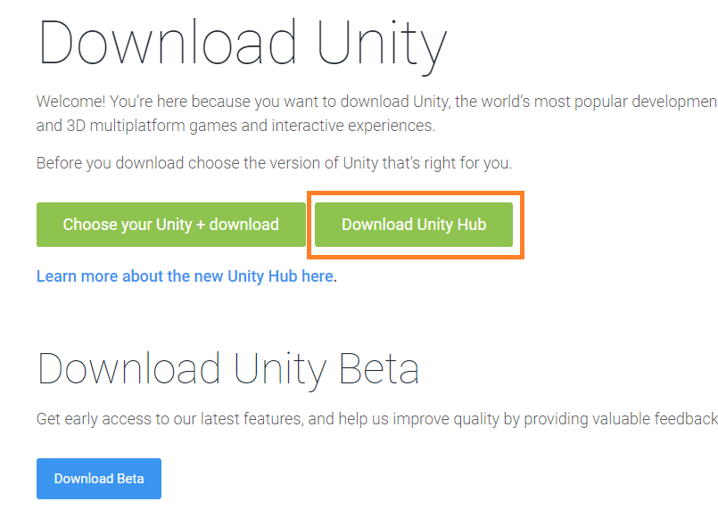
Download Unity Hub
Go to https://unity3d.com/get-unity/download
Click on “Download Unity Hub”
What is Unity Hub? - Unity offers various versions and modules. Unity Hub is a helper app that does all of the installation work for you!
Follow the standard wizard for installation. It should take less than a minute.

Slide 3
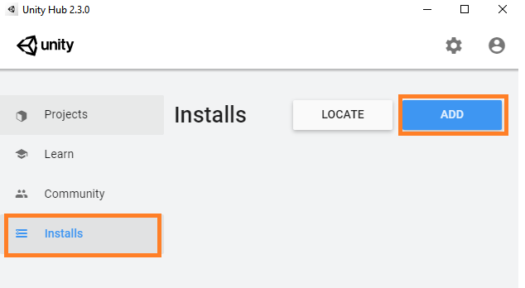
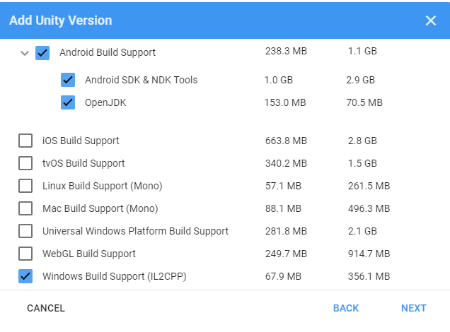
Installing the Unity Engine and its modules
Start Unity Hub
Go to Installs
Press ADD
Choose Unity 2019.3
Check the following modules
Android Build Support
Android SDK & NDK tool
OpenJDK
Window Build Support (IL2CPP)
If you don’t have Visual Studio Community make sure you check it as well
If you plan to build for iOS (Apple App Store) additionally check iOS Build Support

Slide 4
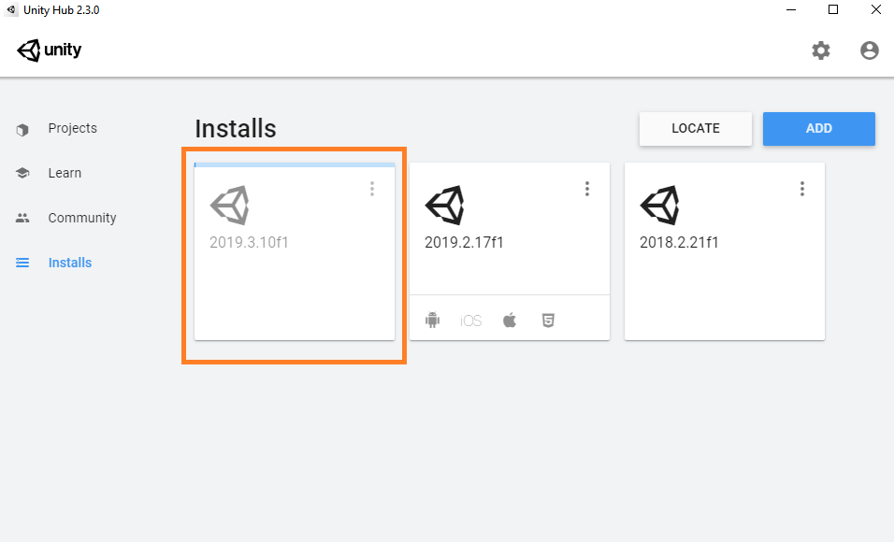
Wait for the installation to complete
Blue bar indicates the progress. It might take up to 10min
You can have different versions of the Unity Editor
Each project can use separate version

